Slide 1


Efficient Parameter Optimization
TCAD Enabled Neural Networks
Abdul Hanan Khan
Student - TCAD

Slide 2
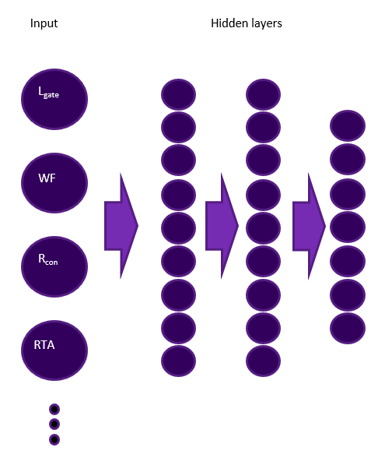
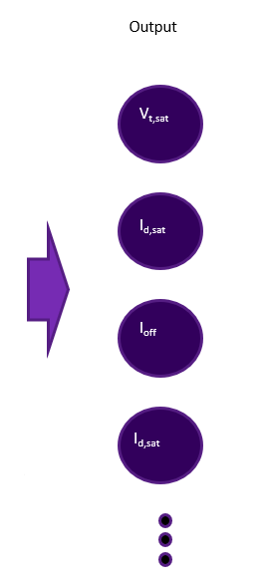
Intro – Part 1
What is an Artificial Neural Network ?
An ANN is a series of algorithm which seeks to understand
the patterns and relationships in a set of data. It follows
the behavior of human brain (neural network).
Structure of the neural network comprises an input layer,
a series of hidden layers and an output layer.
Hidden layers with their neurons and activation function
make up the main body/ computation power of NN
More is not necessarily better – both model accuracy and runtime
can be optimized, and this optimum differs for different problems.
➔ This is the point of this work – finding an optimum structure
Notes:
Neurons hold and transfer information between each other and also from one layer to the other

Slide 3
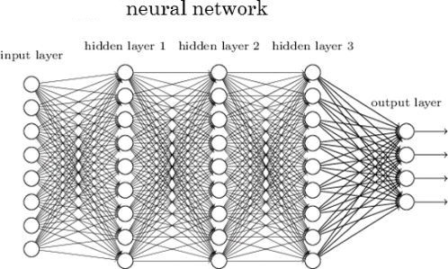
Intro – Part 2
Parameters of neural network
Typically, weights associated with neurons are the parameters.
These parameters are adapted during the training process,
when model learns the patterns of the data set.
Hyper parameters of neural network
Hyper parameters are the variables which determine the structure of NN
They also constitute of external parameters which affect its performance.
Some examples of hyper parameters:
Number of hidden layers, number of neurons within each layer,
Epochs (Training steps).

Slide 4
Strategy
Model creation shouldn’t take longer than a week
Goal
Instead of manually setting up hyperparameters for a neural network configuration, let the model itself select the best configuration from multiple options.
Training multiple networks simultaneously --> Parallelization
Automated Process
One major script that generates everything.
Notes:
We want the model to tell us what is the best configuration for a given dataset.

Slide 5
Hyperparameter Optimization
Hyper parameter optimization is the process of for finding the best hyperparameters for a NN model with respect to a certain dataset.
This process of searching can be carried out in different ways.
Random search
Grid search
Bayesian optimization search (Most optimal)
Notes:
Why we need a NN model (Inputs = Features & Outputs = Elect. parameters) learn the behavior of SC

Slide 6
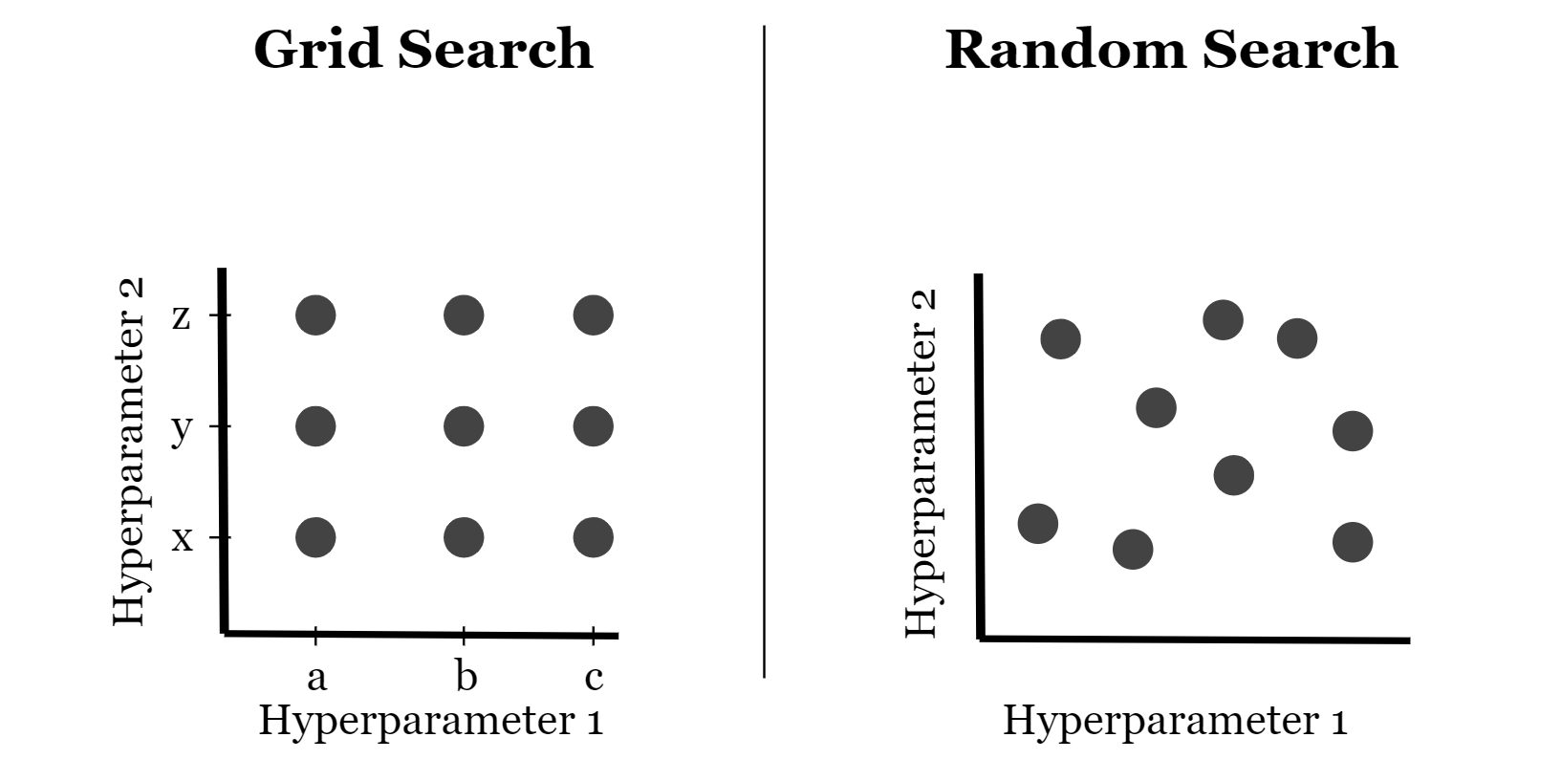
Search Algorithms – Part-1
Grid & Random Search
Grid Search
Grid search considers all the possible combinations for the given hyperparameter values.
Disadvantage:
For higher values, it can be computational expensive
For 4 hidden layers, with 12 possible values for number of neurons in each layer ~ 21,000 different combinations to try.
Random Search
Random search selects random values from given hyperparameter values.
Disadvantage:
Randomly selects combinations for a certain number of times. Can skip important combinations and will probably not find the global minimum.

Slide 7
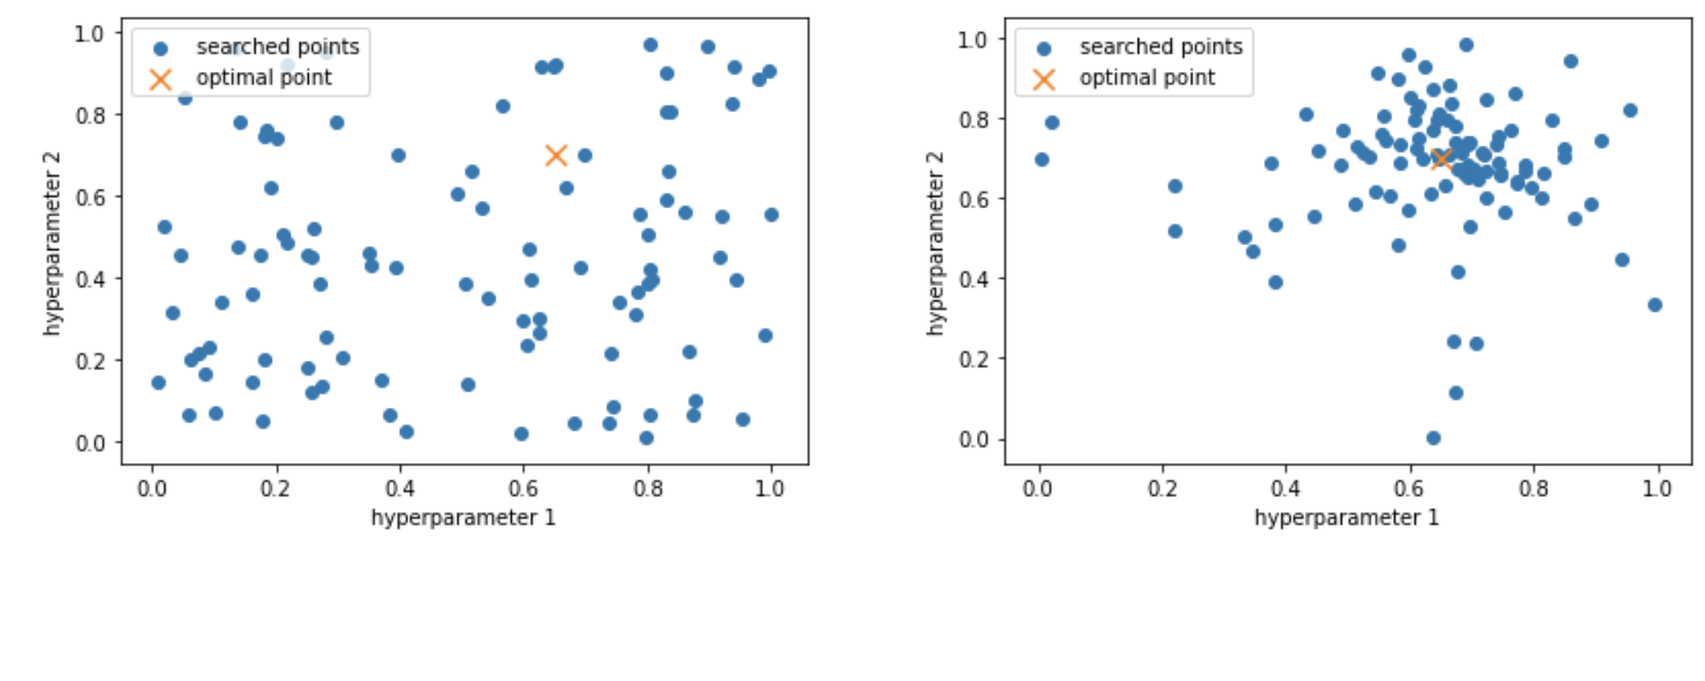
Search Algorithms – Part-2
Bayesian optimization search
Random Search
Bayesian optimization Search
Bayesian optimization
It evaluates past model’s configuration information to select hyperparameter values for the new model. With this learning feature, it takes less time to find the optimal hyperparameters to get best accuracy.
Disadvantage:
This method is sequential (relies on its previous iteration) ,can be computational expensive

Slide 8
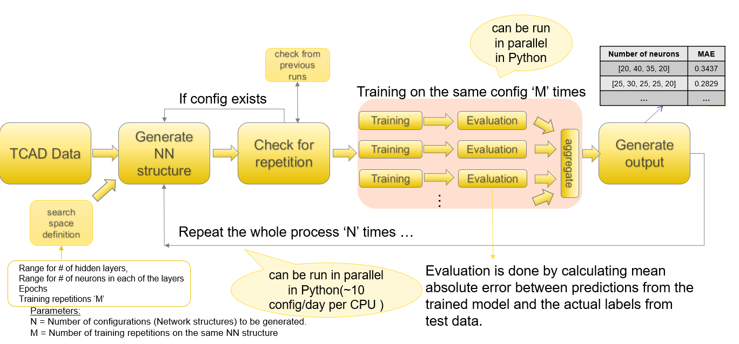
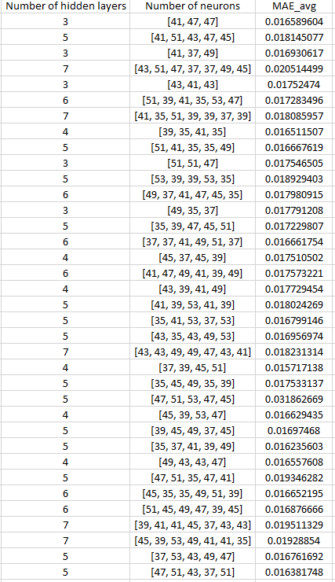
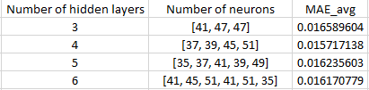
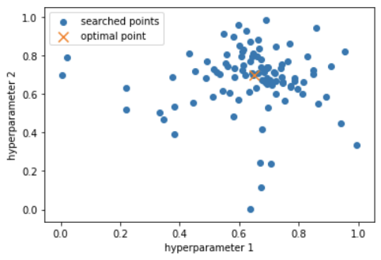
Strategy
The idea is to first conduct a wide range search, highly parallelized, using random search.
Pick top 30 configurations from random search output. This will consist of multiple configurations with same number of hidden layers (with different number of neurons). Pick the best performing config for each of the hidden layer configurations existing in these top 30 → Input for narrow search.
Run narrow search, using Bayesian optimization, for each of the top picked hidden layer configs (In parallel).
Output → Best performing models with most optimal hyperparameters.
Notes:
saturated

Slide 9
Wide space search (Random search)
can be run in parallel in Python
The idea is to first conduct a wide range search, highly parallelized, using random search.
check from previous runs
Number of neurons | MAE
[20, 40, 35, 20] | 0.3437
[25, 30, 25, 25, 20] | 0.2829
… | …
If config exists
Training on the same config ‘M’ times
Training
Evaluation
TCAD Data
Generate NN structure
Check for repetition
Generate output
Training
Evaluation
aggregate
Training
Evaluation
…
search space definition
Repeat the whole process ‘N’ times …
Range for # of hidden layers,
Range for # of neurons in each of the layers
Epochs
Training repetitions ‘M’
can be run in parallel in Python(~10 config/day per CPU )
Evaluation is done by calculating mean absolute error between predictions from the trained model and the actual labels from test data.
Parameters:
N = Number of configurations (Network structures) to be generated.
M = Number of training repetitions on the same NN structure

Slide 10
Random search output sheet (previously)
Number of hidden layers | Number of neurons | MAE_avg | Idsat_MAE | Idlin_MAE
7 | [37, 41, 35, 53, 37, 53, 41] | 0.01911 | 1.181 | 0.308
4 | [41, 53, 35, 49] | 0.0159 | 0.811 | 0.176
3 | [51, 37, 37] | 0.0175 | 0.962 | 0.19
6 | [35, 49, 41, 35, 35, 53] | 0.0185 | 0.8287 | 0.245
5 | [41, 47, 35, 39, 53] | 0.0168 | 0.976 | 0.167
7 | [35, 47, 53, 49, 43, 39, 39] | 0.019 | 1.31 | 0.246
Average Runtime (min)
18.5
30.5
23.75
19.8
32.6
29
. . . . .
.
.
.
.

Slide 11
Random search output sheet (Updated)
Number of hidden layers | Number of neurons | MAE_avg | Idsat_% | Idsat_abs | Idlin_% | Idlin_abs
4 | [80, 40, 55, 50] | 0.016 | 0.081 | 0.706 | 0.097 | 0.174
5 | [75, 85, 55, 85, 65] | 0.0165 | 0.093 | 0.804 | 0.1006 | 0.179
6 | [45, 60, 80, 90, 60, 75] | 0.0166 | 0.097 | 0.837 | 0.106 | 0.191
5 | [60, 60, 80, 70, 45] | 0.0167 | 0.108 | 0.940 | 0.098 | 0.176
3 | [95, 50, 80] | 0.0168 | 0.092 | 0.797 | 0.112 | 0.201
3 | [55, 60, 90] | 0.0175 | 0.102 | 0.884 | 0.098 | 0.176
Average Runtime (min)
18.5
23.75
30.5
24
16
16.3
. . . . .
.
.
.
.
Each label has two measures of evaluation.
First represents the percentage difference between the true and predicted labels.
Second represents the absolute difference between true and predicted labels. (in original label scale)

Slide 12

Narrow space search (Bayesian Opt.)
Best configs from output of wide search will be used as input for narrow search
Training and Evaluation
TCAD Data
Generate NN structure
Best model
Number of neurons | MAE
[56, 56 , 48, 54] | 0.0154
search space definition
Repeat the whole process ‘N’ times
From wide search (Random search)
E.g.:
Neuron_range ~ 10 (search space generator)
[37 ±10, 39 ±10, 45 ±10, 51 ±10]
Can be run in parallel in Python (Minimal because it is sequential)
Parameters:
N = Number of trials.

Slide 13
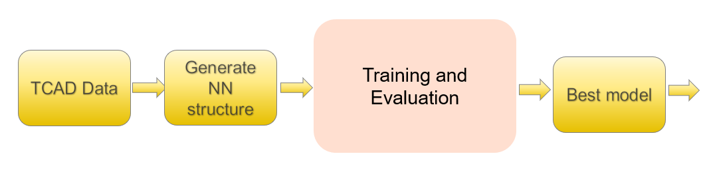
Narrow space search (Bayesian Opt.)
Can be run in
parallel as independent jobs
Narrow space search will be implemented for all the best configs (In parallel)
Job 1
Number of neurons | MAE
[56, 56 , 48, 54] | 0.0153
Job 2
Number of neurons | MAE
[52, 52 , 50, 36, 56] | 0.0156
Job 3
Number of neurons | MAE
[44, 36 , 44, 40, 58] | 0.0155
Job 4
Number of neurons | MAE
[48, 48 , 50, 40, 40,42] | 0.0158

Slide 14
Summary
The idea is to first conduct a wide range search, highly parallelized, using random search.
Pick top 30 configurations from random search output. This will consist of multiple configurations with same number of hidden layers (with different number of neurons). Pick the best performing config for each of the hidden layer configurations existing in these top 30 → Input for narrow search.
Run narrow search, using Bayesian optimization, for each of the top picked hidden layer configs (In parallel).
Output → Best performing models with most optimal hyperparameters.

Slide 15
Threshold evaluation
Threshold Evaluation
Models
Top models
Number of neurons | MAE
[20, 40, 35, 20] | 0.0343
[25, 30, 25, 25, 20] | 0.0282
… | …
. . . . .
Inputs
Type of evaluation:
Percentage
Absolute difference
Both
Threshold values:
Percentage difference (per label or one for all)
Absolute difference (per label)
Based on the evaluation type selected, It can evaluate based on percentage, absolute difference or both.
Models which pass the threshold evaluation will be selected and exported into an excel sheet..

Slide 16
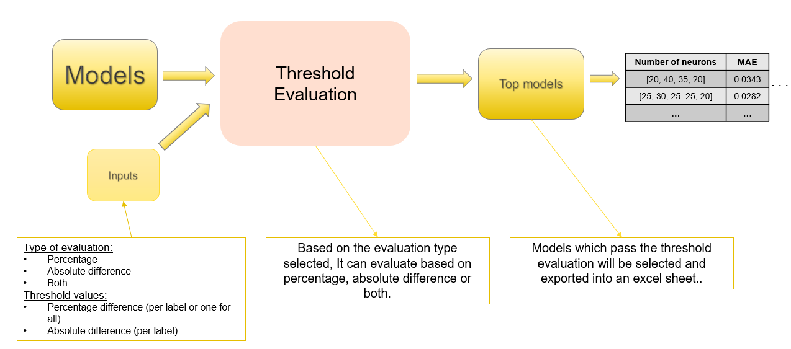
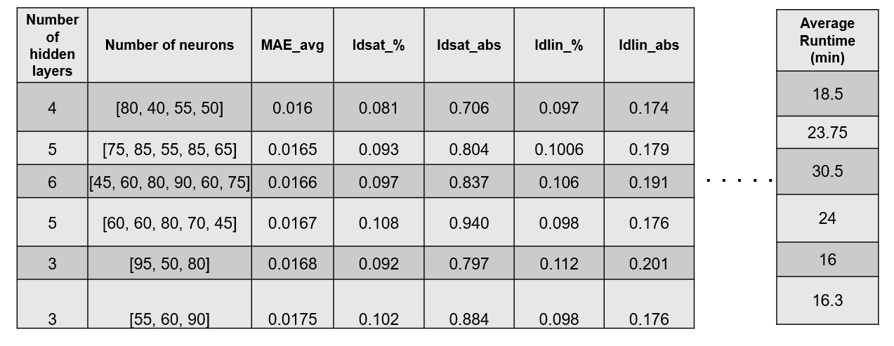
Threshold evaluation
HPO Output
Threshold Evaluation
Best Models

Slide 17
Bill’s Threshold values
Electrical Parameters | Bill |  | Luke |  | Ryan
 | Abs diff | % diff | Abs diff | % diff | Abs diff | % diff
Idsat | 20 | 2 | - | 2 | Within 0.5 Sigma
Idlin | 10 | 5 | - | 5 | Within 0.5 Sigma
Ieff | 15 | 3 | - | 3 | Within 0.5 Sigma
Ioff | - | 50 | - | 10 | Within 0.5 Sigma
Vtsat | 20 | 10 | 8 | 3 | Within 0.5 Sigma
Vtlin | - | - | 10 | 7 | Within 0.5 Sigma
DIBL | 4 | 5 | - | - | Within 0.5 Sigma

Slide 18
Bill’s Threshold values (Old TCAD Data)
22FDX flavors | TCAD Simulations | Idsat | Idlin | Vtsat | Vtlin | DIBL | Ieff | Ioff
SLVT | 150,000 | ✓ | ✓ | ✓ | ✓ | ✓ | ✓ | ✓
LVT | 23000 | ✓ | ✓ | ✓ | ✓ | ✓ | ✓ | ✓
RVT | 54000 | ✓ | ✓ | ✓ | ✓ | ✓ | ✓ | ✓
HVT | 5000 | ✓ | ✓ | ✓ | ✓ | ✓ | ✓ | ✓
Failed Luke’s 3 % diff threshold (Min diff is ~ 5 %)

Slide 19
Bill’s Threshold values (TCAD Data Update)
22FDX flavors | TCAD Simulations | Idsat | Idlin | Vtsat | Vtlin | DIBL | Ieff | Ioff
SLVT | 26,467
LVT | 142,176 | ✓ | ✓ | ✓ | ✓ | ✓ | ✓ | ✓
RVT | 27,000 | ✓ | ✓ | ✓ | ✓ | ✓ | ✓ | ✓
HVT | 18,766 | ✓ | ✓ | ✓ | ✓ | ✓ | ✓ | ✓

Slide 20
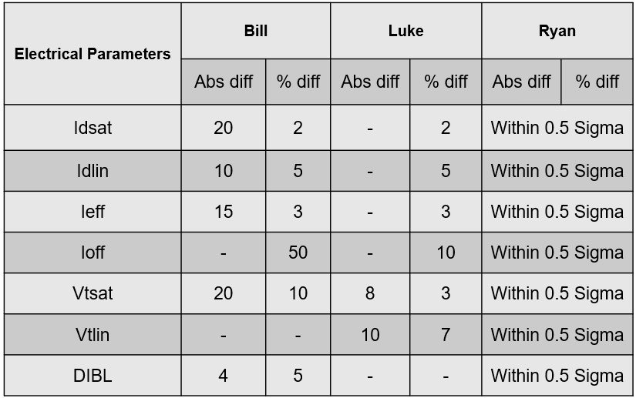
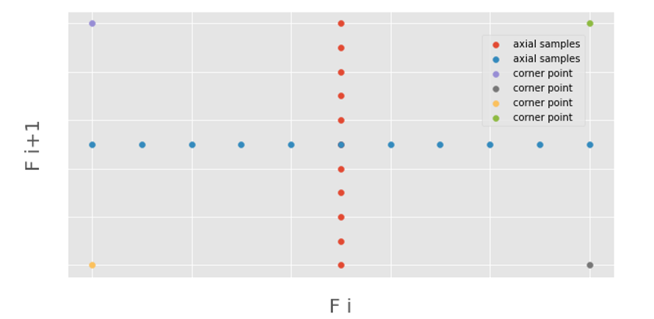
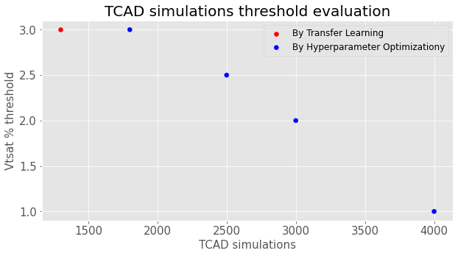
RVT TCAD Simulations Threshold Evaluation
Training data for these ML models initially includes axial and feature pairwise corner samples. Additional TCAD simulations are then added into the training data till the evaluation criteria is satisfied. Testing data for evaluation consists of all available TCAD simulations apart from the ones used as training data.
TCAD Simulations | Norm MAE | Vtsat % | Idsat | Idlin | Vtsat | Vtlin | DIBL | Ieff | Ioff
1300 | 0.091 | 3 | ✓ | ✓ | ✓ | ✓ | ✓ | ✓ | ✓
1800 | 0.09 | 3 | ✓ | ✓ | ✓ | ✓ | ✓ | ✓ | ✓
2500 | 0.08 | 2.5 | ✓ | ✓ | ✓ | ✓ | ✓ | ✓ | ✓
3000 | 0.073 | 2 | ✓ | ✓ | ✓ | ✓ | ✓ | ✓ | ✓
4000 | 0.065 | 1 | ✓ | ✓ | ✓ | ✓ | ✓ | ✓ | ✓
Using Transfer Learning HVT → RVT

Slide 21
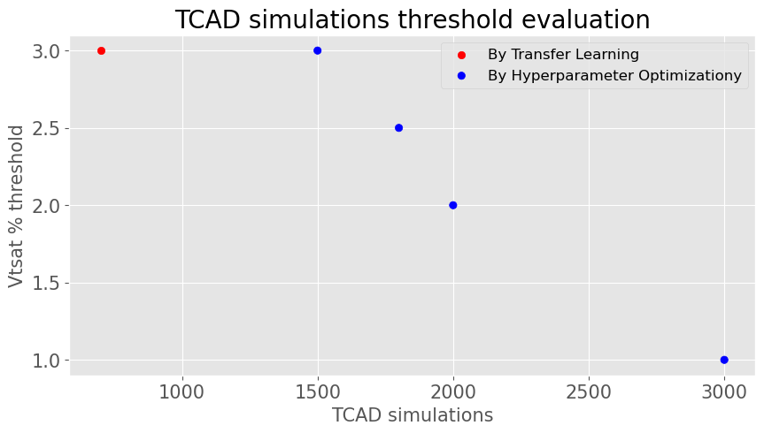
HVT TCAD Simulations Threshold Evaluation
Training data for these ML models initially includes axial and feature pairwise corner samples. Additional TCAD simulations are then added into the training data till the evaluation criteria is satisfied. Testing data for evaluation consists of all available TCAD simulations apart from the ones used as training data.
TCAD Simulations | Norm MAE | Vtsat % | Idsat | Idlin | Vtsat | Vtlin | DIBL | Ieff | Ioff
700 | 0.061 | 3 | ✓ | ✓ | ✓ | ✓ | ✓ | ✓ | ✓
1500 | 0.06 | 3 | ✓ | ✓ | ✓ | ✓ | ✓ | ✓ | ✓
1800 | 0.058 | 2.5 | ✓ | ✓ | ✓ | ✓ | ✓ | ✓ | ✓
2000 | 0.057 | 2 | ✓ | ✓ | ✓ | ✓ | ✓ | ✓ | ✓
3000 | 0.052 | 1 | ✓ | ✓ | ✓ | ✓ | ✓ | ✓ | ✓
Using Transfer Learning RVT → HVT
Notes:
ADD FEATURE MANIPULATION, MENTIONING THAT WE REDUCED/INCREASED THE NUMBER OF FEATURES WHILE IMPLEMENTING TRANSFER LEARNING.

Slide 22
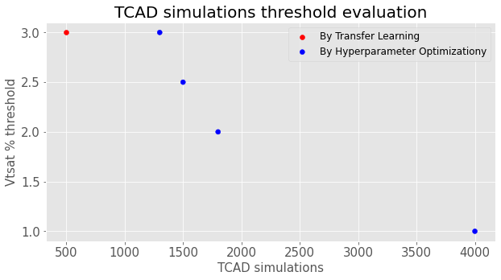
LVT TCAD Simulations Threshold Evaluation
Training data for these ML models initially includes axial and feature pairwise corner samples. Additional TCAD simulations are then added into the training data till the evaluation criteria is satisfied. Testing data for evaluation consists of all available TCAD simulations apart from the ones used as training data.
TCAD Simulations | Norm MAE | Vtsat % | Idsat | Idlin | Vtsat | Vtlin | DIBL | Ieff | Ioff
500 | 0.0533 | 3 | ✓ | ✓ | ✓ | ✓ | ✓ | ✓ | ✓
1300 | 0.053 | 3 | ✓ | ✓ | ✓ | ✓ | ✓ | ✓ | ✓
1500 | 0.052 | 2.5 | ✓ | ✓ | ✓ | ✓ | ✓ | ✓ | ✓
1800 | 0.051 | 2 | ✓ | ✓ | ✓ | ✓ | ✓ | ✓ | ✓
4000 | 0.041 | 1 | ✓ | ✓ | ✓ | ✓ | ✓ | ✓ | ✓
Using Transfer Learning HVT → LVT

Slide 24
Best configs from top 30
From output of random search (~ 2000 configs), we select top 30 with best MAE scores. From these top 30, we select the best performing configuration for each of the hidden layer configs.
Number of hidden layers | Number of neurons | MAE_avg
3 | [41, 47, 47] | 0.0165
4 | [37, 39, 45, 51] | 0.0157
5 | [35, 37, 41, 39, 49] | 0.0162
6 | [41, 45, 51, 41, 51, 35] | 0.01617
These will serve as inputs for narrow searches, using Bayesian optimization. (will be performed in parallel).

Slide 25
Summary - 2
The practical problem at hand: For a given technology, we have, say, ~10 devices we’d like to model: NFET & PFET (Multiple Vt flavors of each), and some EG.
These are devices similar enough that a Neural Net which is optimized (#layers, #neurons, …) for one device should be close enough to work well for the other devices.
We have found, for the SLVT SG NFET, that 5 layers, each of 35-50 neurons, provides a nice optimum of accuracy and speed.
For our other devices, we can use this same neural net and feel confident we’re getting good results.

Slide 26
Summary - 2
Artificial Neural Networks are very powerful tools which, with their combination of algorithms, can be used for solving almost any type of statistical problem with very good results.
However, the process of setting up suitable hyper parameters for a given dataset is mostly based on hit and trial and thus can get repetitive.
With the implementation of efficient parameter optimization method as shown in the previous slides, This whole process can be automated and can lead to efficient results.
Further steps
Constructing a right neural model can be of much use as it can give a lot of information related to the importance and level of contribution of each one of the inputs to the respective outputs. Which is one of the next steps, known as feature importance.

Slide 27
Evaluation Measure
Finding threshold for number of simulations based on MAE,MSE scores and mean & stds of predicted outputs/labels.

Slide 28
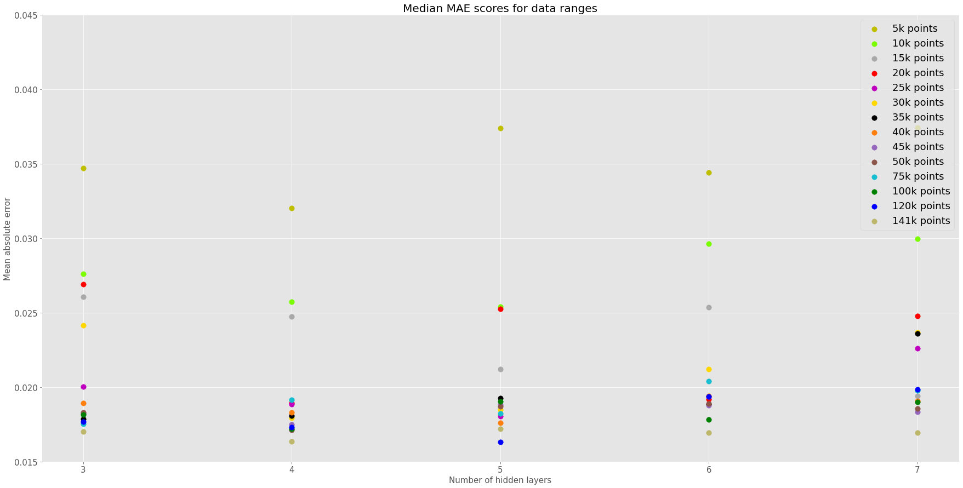
Relation b/w simulation points & MAE
Using ~ 25k simulations as training data for the model, with 4-6 hidden layer configurations, generates good results.

Slide 29
Output table
Data ranges | MAE | MSE | Idsat_mean | Idsat_std | Idlin_mean | Idlin_std
2k points | 0.041 | 0.0061 | 861.6 | 86.925 | 179.34 | 14.154
5k points | 0.031 | 0.0035 | 863.4 | 87.44 | 179.73 | 14.28
10k points | 0.020 | 0.00133 | 863.5 | 86.73 | 179.63 | 14.28
15k points | 0.0191 | 0.00122 | 863.81 | 87.29 | 179.64 | 14.25
20k points | 0.0171 | 0.00089 | 863.75 | 86.95 | 179.72 | 14.35
25k points | 0.0179 | 0.00095 | 862.96 | 87.11 | 179.67 | 14.41
30k points | 0.018 | 0.00096 | 864.16 | 86.82 | 179.78 | 14.26
35k points | 0.0163 | 0.00084 | 863.35 | 87.33 | 179.66 | 14.45
40k points | 0.017 | 0.00088 | 864.21 | 87.34 | 179.62 | 14.26
45k points | 0.0171 | 0.00090 | 862.97 | 87.029 | 179.62 | 14.28
50k points | 0.01789 | 0.000915 | 863.12 | 87.86 | 179.67 | 14.38
. . . . .
.
.
.
.

Slide 30
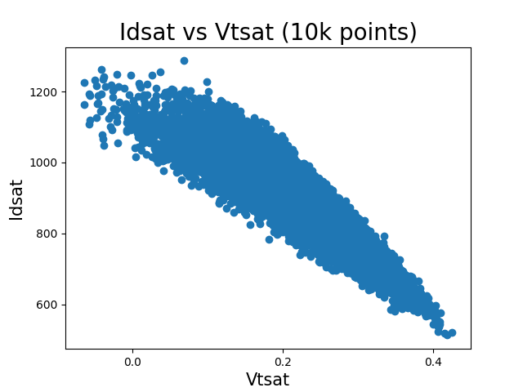
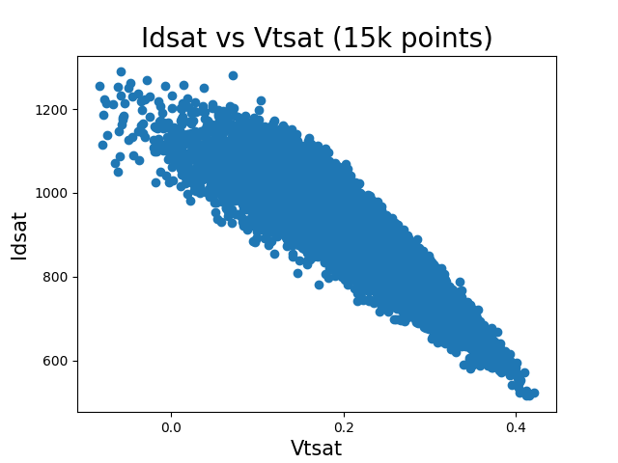
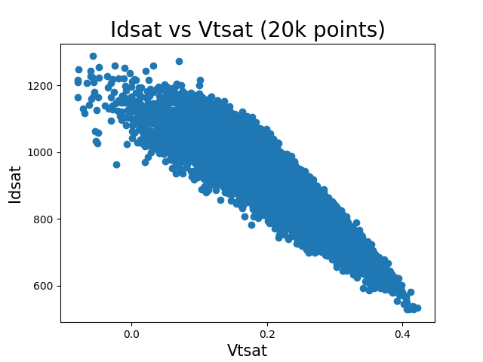
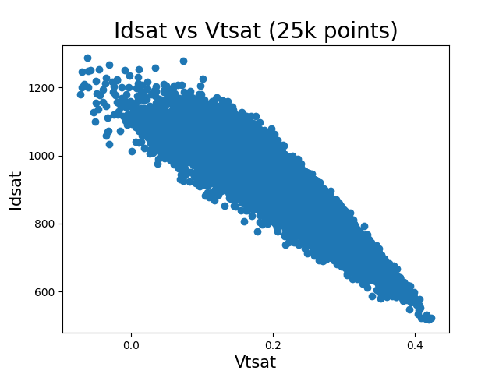
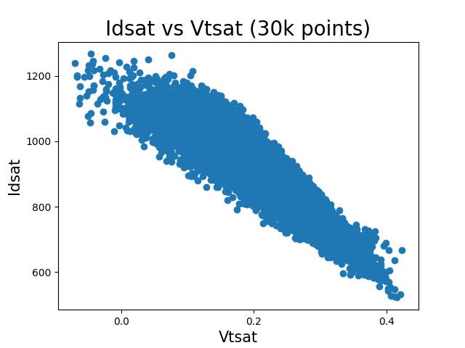
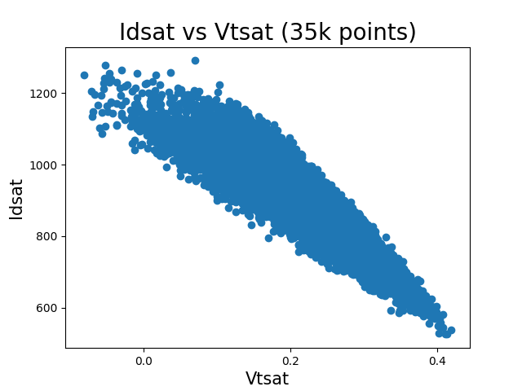
Idsat vs Vtsat plots, part-1

Slide 31
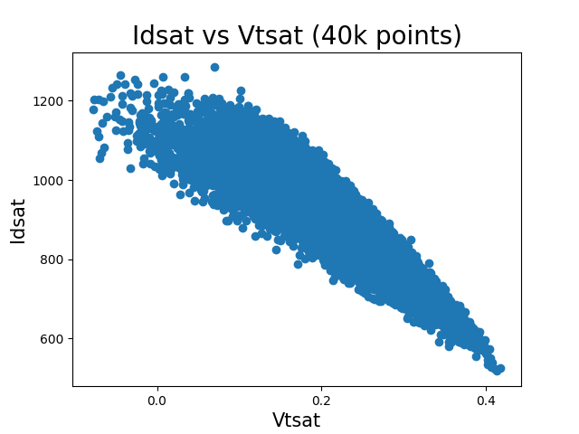
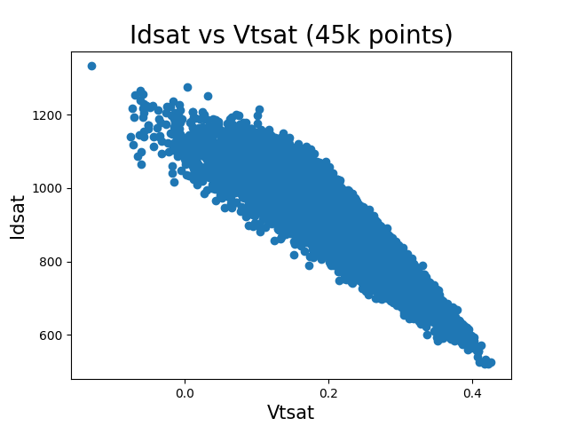
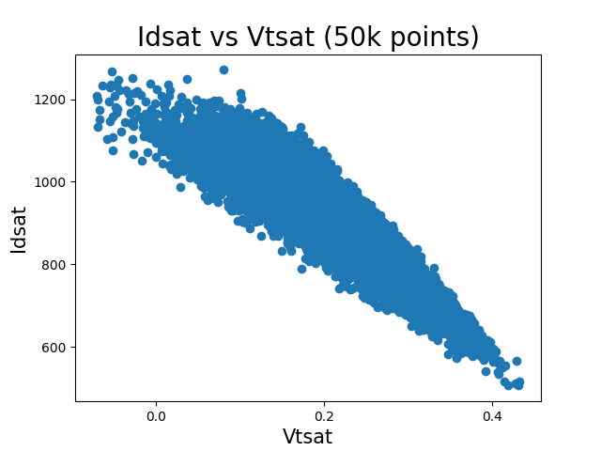
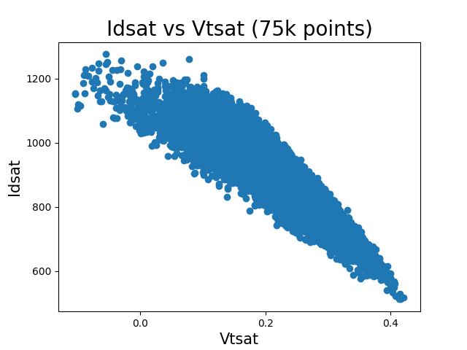
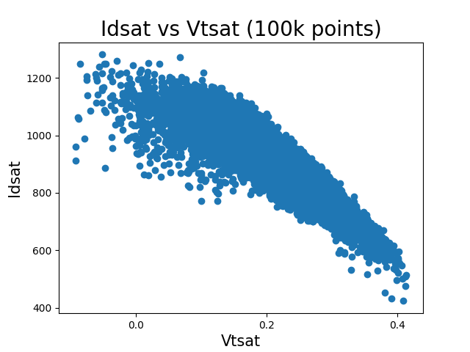
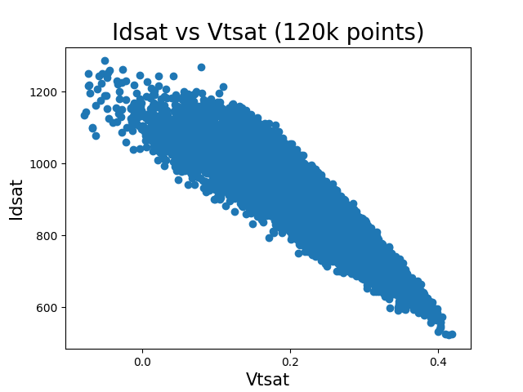
Idsat vs Vtsat plots, part-2

Slide 32
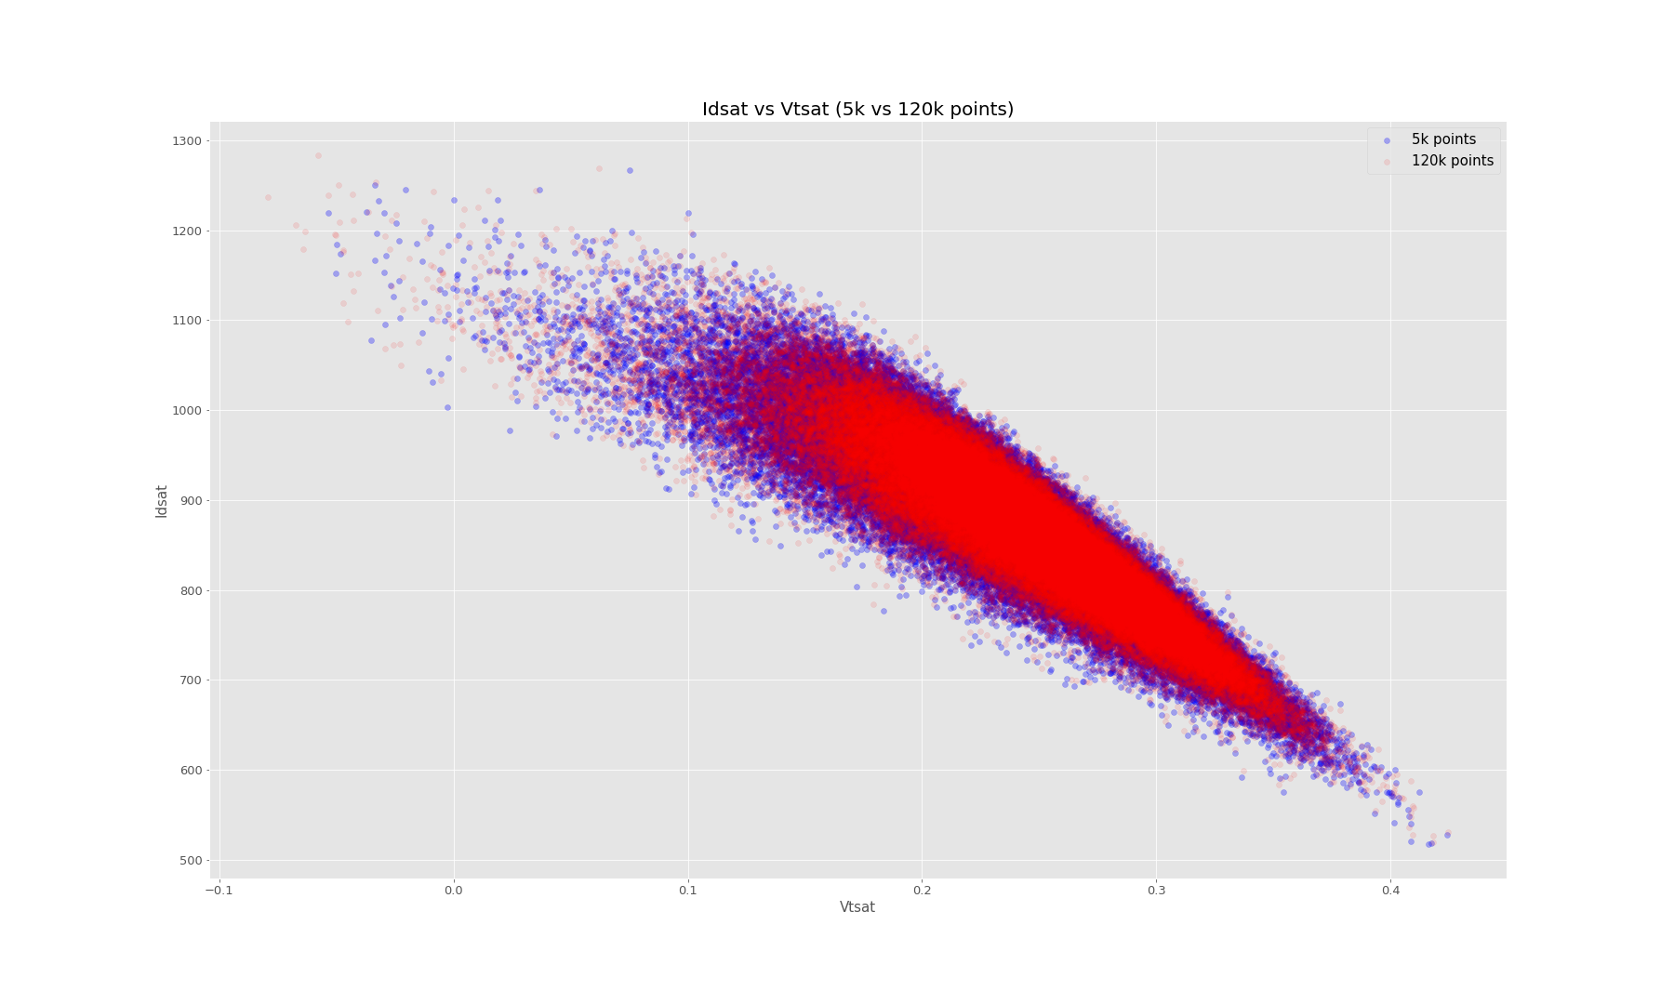
Idsat vs Vtsat plots, part-3
It can be seen that Idsat vs Vtsat plots, by using 5k and 120k points for training, are quite similar.

Slide 33
Feature Importance (Using SHAP)
Optimized Neural Networks are powerful enough to give an analysis of importance of each feature and their impact on each one of the outputs. In our case, the best model was chosen to conduct feature importance by calculating shap values.
Shap method basically fluctuates the value of each feature and measure their impact accordingly. Based on this, it assigns a shapley value to each feature. Features with large absolute shapley values are more important than the ones with lower values.
Local feature importance: plots show shapley values of each of the features to get each label’s predicted (expected) value. shapley value of a feature correlates to its impact on predicting the output. (Higher shapley value → higher impact on label’s prediction).
Global feature importance: plot shows the value of each of the features to get mean predicted (expected) value of the labels.
Notes:
These shapley values correlated with the feature’s scaled value.

Slide 34
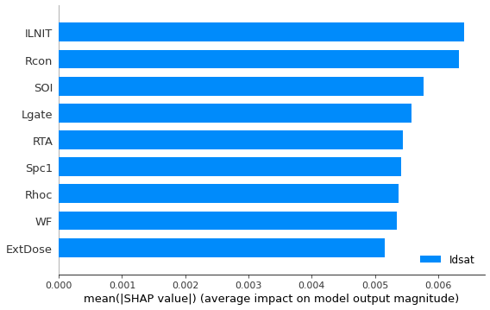
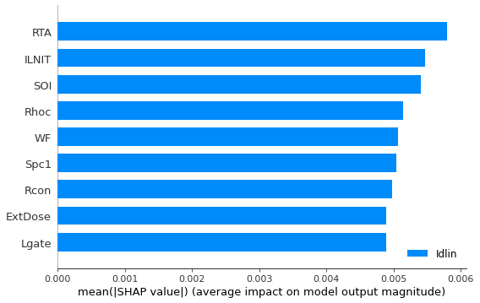
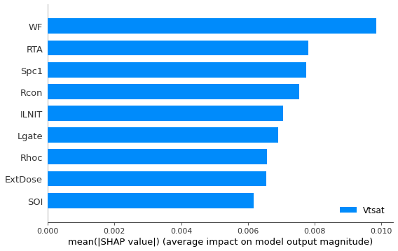
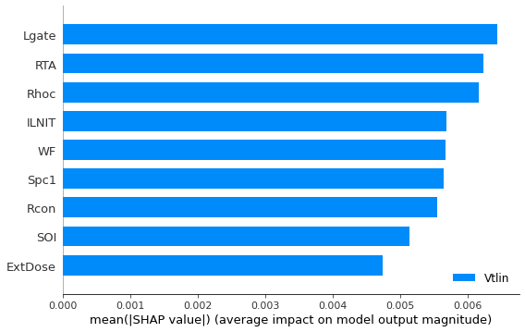
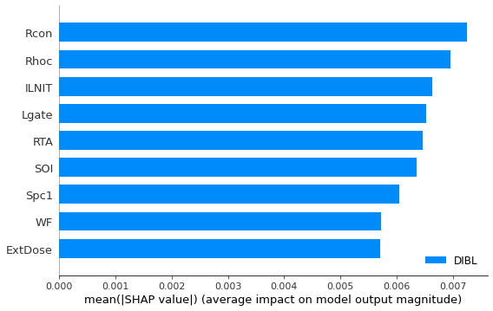
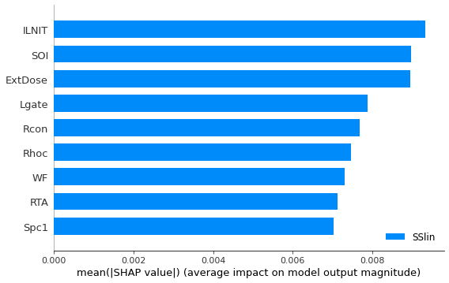
Local Feature Importance, part-1

Slide 35
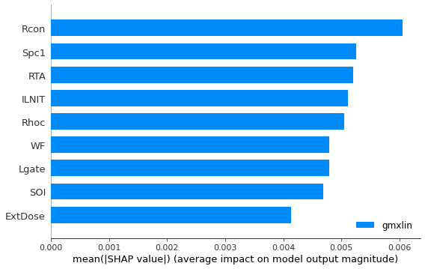
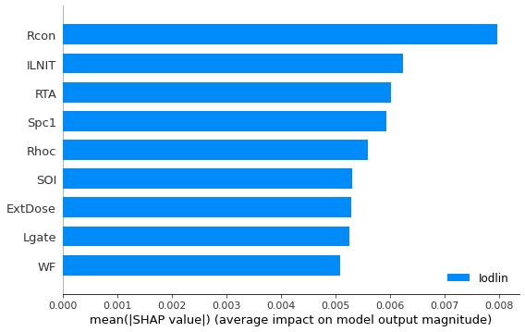
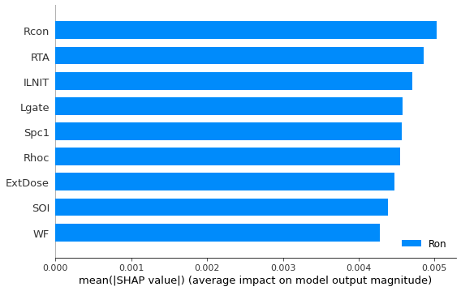
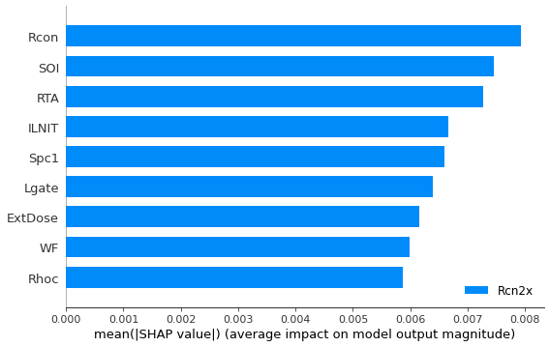
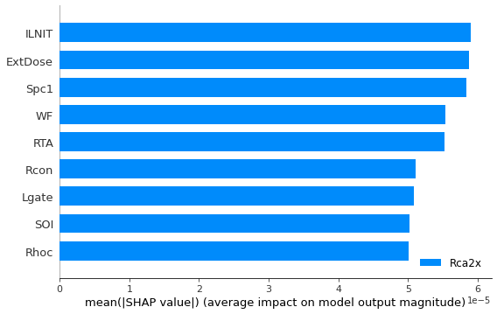
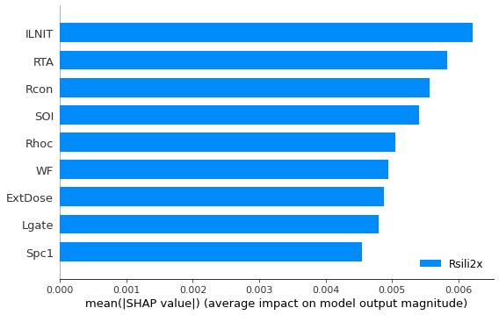
Local Feature Importance, part-2

Slide 36
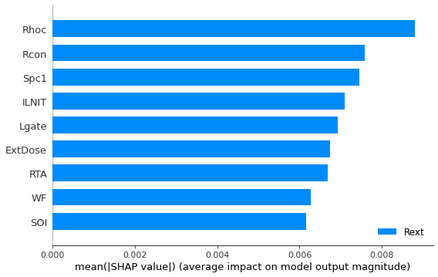
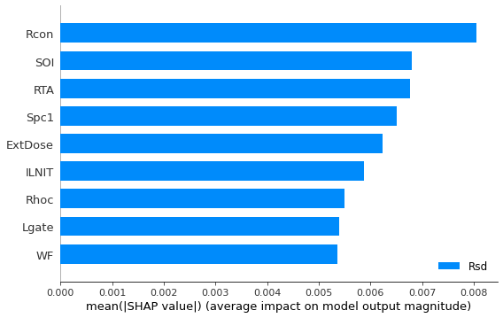
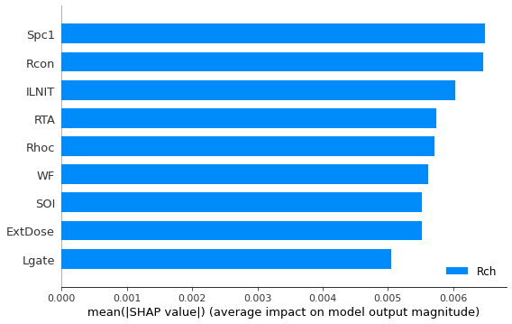
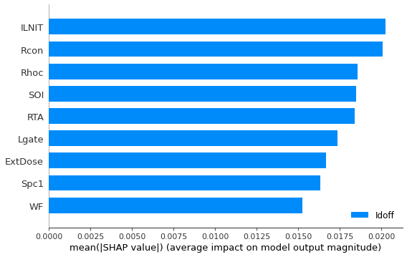

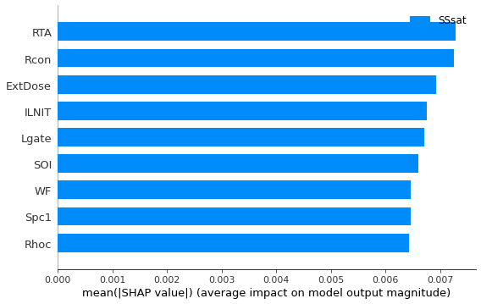
Local Feature Importance, part-3

Slide 37
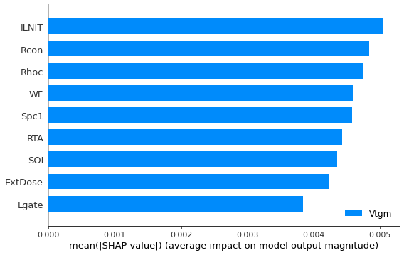
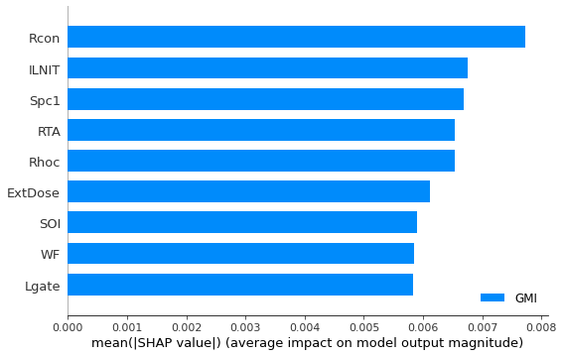


Local Feature Importance, part-4

Slide 38

Global Feature Importance

Slide 39
Transfer Learning
For a given technology, we have, say, ~10 devices we’d like to model: NFET & PFET (Multiple Vt flavors of each), and some EG.
These are devices similar enough that a Neural Net which is optimized (#layers, #neurons, …) for one device can be used to aid the training process for another.
In order to implement this, we can use transfer learning.
Transfer learning stands for utilizing feature representations from a pre-trained model so that we do not have to train a new model from scratch, and it comes in handy when we do not have a huge data set.
By implementing transfer learning, we can reduce the number of simulations needed.

Slide 40

Transfer Learning
Generating Base model
Hidden layer 1
Number of neurons | MAE (Error)
[215] | 0.056
Input layer
Output layer
We will select the most optimal pre-trained models from the previous flavor (RVT) and use it as our base model.

Slide 41

Transfer Learning
Generating Base model
Hidden layer 1
Hidden layer 2
Hidden layer 3
Hidden layer 4
Input layer
Output layer
Number of neurons | MAE (Error)
[51, 45, 42, 49] | 0.0159
We will select the most optimal pre-trained models from the previous flavor (SLVT) and use it as our base model.

Slide 42

Transfer Learning
Generating Base model
Hidden layers
Hidden layers
Input layer
Output layer
Input layer
Output layer
In case the inputs/features or outputs/electrical parameters are different for this flavor, we will have to create new input and output layers. However, a trained neural network does not allow dimensionality changes, therefore we will create a new model with the same hidden layer and nodes as base model and will then transfer the weights existing between hidden layer (Information carrying elements), from base model to the new one.
Generating a new model gives us more flexibility e.g.: Adding/reducing features or outputs.
Base model
New model

Slide 43


Transfer Learning
Generating Base model
Hidden layers
Output layer
Input layer
Hidden layers
Output layer
Input layer
In case the inputs/features or outputs/electrical parameters are different for this flavor, we will have to create new input and output layers. However, a trained neural network does not allow dimensionality changes, therefore we will create a new model with the same hidden layers and nodes as base model and will then transfer the weights existing between hidden layer (Information carrying elements), from base model to the new one.
Generating a new model gives us more flexibility e.g.: Adding/reducing features or outputs.
Base model
New model

Slide 44

Transfer Learning
Adding features
Input layer
Hidden layer
Output layer
As we move from one flavor to another, we will notice that the features are slightly different. E.g.:
RVT → 9 features.
HVT → 10 features, BF2Dose is unique.
Approach: Add a new weight vector for BF2Dose. (Consisting of random assigned start weights). Transfer weight vectors of the remining 9 similar features, from RVT to HVT’s model.
10th feature for HVT

Slide 45




Transfer Learning
Hidden layer
NN Mathematical explanation
Input layer
$${H.L}_{1}=W^{T}∗ Input layer$$
. . . . .
Hidden Layer #1
Weight Matrix (Transposed)
Input layer
$\left(\begin{aligned}N_{1} \\ N_{2} \\ N_{3} \\ . \\ . \\ . \\ N_{m}\end{aligned}\right)$ = $\left(\begin{aligned}W_{11}{ W}_{12}{ W}_{13}……W_{1n−1 }W_{1n}′ \\ W_{21}{ W}_{22}{ W}_{23}……W_{2n−1} W_{2n}′ \\ W_{31}{ W}_{32}{ W}_{33}……W_{3n−1} W_{3n}′ \\ . \\ . \\ . \\ W_{m1}{ W}_{m2}{ W}_{m3}……W_{m−1n−1} W_{mn}′\end{aligned}\right)$ x $\left(\begin{aligned}F_{1} \\ F_{2} \\ F_{3} \\ . \\ . \\ . \\ F_{n−1} \\ F_{n}′\end{aligned}\right)$
$$\left(m,n\right)$$
Notes:
Change vector positions, 2nd vector (should be in 1st place) should be transposed

Slide 46







Transfer Learning
Hidden layer
Inputs
$$\left(\begin{aligned}F_{1} \\ F_{2} \\ F_{3} \\ . \\ . \\ . \\ F_{n}\end{aligned}\right)$$
$\left(\begin{aligned}N_{1} \\ N_{2} \\ N_{3} \\ . \\ . \\ . \\ N_{n}\end{aligned}\right)$ = $\left(\begin{aligned}W_{11}{ W}_{12}{ W}_{13}……W_{1n} \\ W_{21}{ W}_{22}{ W}_{23}……W_{2n} \\ W_{31}{ W}_{32}{ W}_{33}……W_{3n} \\ . \\ . \\ . \\ W_{m1}{ W}_{m2}{ W}_{m3}……W_{mn}\end{aligned}\right)$ x $\left(\begin{aligned}F_{1} \\ F_{2} \\ F_{3} \\ . \\ . \\ . \\ F_{n}\end{aligned}\right)$
Adding features
$$\left(m=215,n=9\right)$$
As we move from one flavor to another, we will notice that the features are slightly different. E.g.:
RVT → 9 features.
HVT → 10 features, BF2Dose is unique.
Approach: Add a new weight vector for BF2Dose (Consisting of randomly assigned start weights). Transfer weight vectors of the remining 9 similar features, from RVT to HVT’s model.
$$\left(\begin{aligned}F_{1} \\ F_{2} \\ F_{3} \\ . \\ . \\ . \\ F_{n−1} \\ F_{n}\end{aligned}\right)$$
$\left(\begin{aligned}N_{1} \\ N_{2} \\ N_{3} \\ . \\ . \\ . \\ N_{m}\end{aligned}\right)$ = $\left(\begin{aligned}W_{11}{ W}_{12}{ W}_{13}……{ W}_{1n−1}{ W}_{1n} \\ W_{21}{ W}_{22}{ W}_{23}……{ W}_{2n−1}{ W}_{2n} \\ W_{31}{ W}_{32}{ W}_{33}……{ W}_{3n−1}{ W}_{3n} \\ . \\ . \\ . \\ W_{m1}{ W}_{m2}{ W}_{m3}……{ W}_{mn−1}{ W}_{mn}\end{aligned}\right)$ x $\left(\begin{aligned}F_{1} \\ F_{2} \\ F_{3} \\ . \\ . \\ . \\ F_{n−1} \\ F_{n}\end{aligned}\right)$
Adding BF2Dose
$$\left(m=215,n=10\right)$$
Notes:
Change vector positions, 2nd vector (should be in 1st place) should be transposed

Slide 47






Inputs
Hidden layer
$$\left(\begin{aligned}F_{1} \\ F_{2} \\ F_{3} \\ . \\ . \\ . \\ F_{n}\end{aligned}\right)$$
$\left(\begin{aligned}N_{1} \\ N_{2} \\ N_{3} \\ . \\ . \\ . \\ N_{n}\end{aligned}\right)$ = $\left(\begin{aligned}W_{11}{ W}_{12}{ W}_{13}……W_{1n} \\ W_{21}{ W}_{22}{ W}_{23}……W_{2n} \\ W_{31}{ W}_{32}{ W}_{33}……W_{3n} \\ . \\ . \\ . \\ W_{m1}{ W}_{m2}{ W}_{m3}……W_{mn}\end{aligned}\right)$ x $\left(\begin{aligned}F_{1} \\ F_{2} \\ F_{3} \\ . \\ . \\ . \\ F_{n}\end{aligned}\right)$
Removing feature
$$\left(m,n\right)$$
$$\left(\begin{aligned}F_{1} \\ F_{2} \\ F_{3} \\ . \\ . \\ . \\ F_{n−1} \\ F_{n}\end{aligned}\right)$$
$\left(\begin{aligned}N_{1} \\ N_{2} \\ N_{3} \\ . \\ . \\ . \\ N_{m}\end{aligned}\right)$ = $\left(\begin{aligned}W_{11}{ W}_{12}{ W}_{13}……{ W}_{1n−1}{ W}_{1n} \\ W_{21}{ W}_{22}{ W}_{23}……{ W}_{2n−1}{ W}_{2n} \\ W_{31}{ W}_{32}{ W}_{33}……{ W}_{3n−1}{ W}_{3n} \\ . \\ . \\ . \\ W_{m1}{ W}_{m2}{ W}_{m3}……{ W}_{mn−1}{ W}_{mn}\end{aligned}\right)$ x $\left(\begin{aligned}F_{1} \\ F_{2} \\ F_{3} \\ . \\ . \\ . \\ F_{n−1} \\ F_{n}\end{aligned}\right)$
Adding features
$$\left(m,n\right)$$
Notes:
Change vector positions, 2nd vector (should be in 1st place) should be transposed

Slide 48






Transfer Learning
Hidden layer
Inputs
$$\left(\begin{aligned}F_{1} \\ F_{2} \\ F_{3} \\ . \\ . \\ . \\ F_{9}\end{aligned}\right)$$
$\left(\begin{aligned}N_{1} \\ N_{2} \\ N_{3} \\ . \\ . \\ . \\ N_{50}\end{aligned}\right)$ = $\left(\begin{aligned}W_{11}{ W}_{12}{ W}_{13}……W_{19} \\ W_{21}{ W}_{22}{ W}_{23}……W_{29} \\ W_{31}{ W}_{32}{ W}_{33}……W_{39} \\ . \\ . \\ . \\ W_{m1}{ W}_{m2}{ W}_{m3}……W_{509}\end{aligned}\right)$ x $\left(\begin{aligned}F_{1} \\ F_{2} \\ F_{3} \\ . \\ . \\ . \\ F_{9}\end{aligned}\right)$
Adding features
Removing ExpDose
$$\left(50,9\right)$$
As we move from one flavor to another, we will notice that the features are slightly different. E.g.:
SLVT → 9 features, ExpDose is unique.
HVT → 10 features, GPPDose & BF2Dose are unique.
Approach: Remove the weights of ExpDose while performing transfer learning and copy weight vectors for GPPDose & BF2Dose from a trained HVT model. Transfer weight vectors of the remining 8 similar features, from SLVT to HVT’s model.
$\left(\begin{aligned}N_{1} \\ N_{2} \\ N_{3} \\ . \\ . \\ . \\ N_{50}\end{aligned}\right)$ = $\left(\begin{aligned}W_{11}{ W}_{12}{ W}_{13}……W_{19}^{′} W_{110}^{′} \\ W_{21}{ W}_{22}{ W}_{23}……W_{29}^{′} W_{210}^{′} \\ W_{31}{ W}_{32}{ W}_{33}……W_{39}^{′} W_{310}^{′} \\ . \\ . \\ . \\ W_{501}{ W}_{502}{ W}_{503}……W_{509}^{′} W_{5010}^{′}\end{aligned}\right)$ x $\left(\begin{aligned}F_{1} \\ F_{2} \\ F_{3} \\ . \\ . \\ . \\ F_{9}′ \\ F_{10}′\end{aligned}\right)$
$$\left(\begin{aligned}F_{1} \\ F_{2} \\ F_{3} \\ . \\ . \\ . \\ F_{9} \\ F_{10}\end{aligned}\right)$$
Adding GPP & BF2Dose
$$\left(50,10\right)$$
Notes:
Change vector positions, 2nd vector (should be in 1st place) should be transposed

Slide 49
Transfer Learning
Training
Input layer
Hidden layer
Output layer
For the 9 similar features between RVT and HVT weight vectors (information carrying blocks) along with biases are transferred from a highly trained model (RVT’s model), to a model with less training data (HVT).For the 10th unique feature of HVT (BF2_Dose), training is required to achieve its weight vector w.r.t 9 other features.
10th feature for HVT

Slide 50

Transfer Learning
Freezing transferred weights
During the training process, transferred weight vectors of 9 similar features are frozen while weight vector for 10th unique feature of HVT (BF2_Dose) is allowed to be upgraded, as it is initiated with random starting weights which require adjustment/upgrade.
This training implementation allows adjustment of 10th feature’s weight vector in compatibility with weight vectors of the rest of 9 similar features, at the same time keeping the transferred information from highly trained base model.
Input layer
Hidden layer
Freezing weights
$$\left(\begin{aligned}F_{1} \\ F_{2} \\ F_{3} \\ . \\ . \\ . \\ F_{n−1} \\ F_{n}\end{aligned}\right)$$
$\left(\begin{aligned}N_{1} \\ N_{2} \\ N_{3} \\ . \\ . \\ . \\ N_{m}\end{aligned}\right)$ = $\left(\begin{aligned}W_{11}{ W}_{12}{ W}_{13}……{ W}_{1n−1}{ W}_{1n} \\ W_{21}{ W}_{22}{ W}_{23}……{ W}_{2n−1}{ W}_{2n} \\ W_{31}{ W}_{32}{ W}_{33}……{ W}_{3n−1}{ W}_{3n} \\ . \\ . \\ . \\ W_{m1}{ W}_{m2}{ W}_{m3}……{ W}_{mn−1}{ W}_{mn}\end{aligned}\right)$ x $\left(\begin{aligned}F_{1} \\ F_{2} \\ F_{3} \\ . \\ . \\ . \\ F_{n−1} \\ F_{n}\end{aligned}\right)$
BF2Dose
$$\left(m=215,n=10\right)$$

Slide 51

Transfer Learning
Fine-tuning
Input layer
Hidden layer
After the training process, finetuning is implemented in order to improve model’s performance and insure transferred and learned weight vectors compatibility.
For finetuning, transferred weight vectors are unfrozen and the entire model is trained again, however, with a low learning rate, to avoid overfitting.
After finetuning, the resultant model is used for prediction & evaluation.
Unfreezing weights
$$\left(\begin{aligned}F_{1} \\ F_{2} \\ F_{3} \\ . \\ . \\ . \\ F_{n−1} \\ F_{n}\end{aligned}\right)$$
$\left(\begin{aligned}N_{1} \\ N_{2} \\ N_{3} \\ . \\ . \\ . \\ N_{m}\end{aligned}\right)$ = $\left(\begin{aligned}W_{11}{ W}_{12}{ W}_{13}……{ W}_{1n−1}{ W}_{1n} \\ W_{21}{ W}_{22}{ W}_{23}……{ W}_{2n−1}{ W}_{2n} \\ W_{31}{ W}_{32}{ W}_{33}……{ W}_{3n−1}{ W}_{3n} \\ . \\ . \\ . \\ W_{m1}{ W}_{m2}{ W}_{m3}……{ W}_{mn−1}{ W}_{mn}\end{aligned}\right)$ x $\left(\begin{aligned}F_{1} \\ F_{2} \\ F_{3} \\ . \\ . \\ . \\ F_{n−1} \\ F_{n}\end{aligned}\right)$
BF2Dose
$$\left(m=215,n=10\right)$$

Slide 52
Transfer Learning (single hidden layer)
Results
For HVT: Around 25 % improvement in MAE scores using transfer learning, as compared to standard prior optimization approach (Training from scratch).
Scores obtained from using transfer learning for HVT with around 700 TCAD simulations are similar to what we would get if we had around 1500 TCAD simulations, while training from scratch.
→ Amount of TCAD simulations required to obtain an HVT model which passes the evaluation criteria is reduced by 53%.
Training data | Normalized MAE | Evaluation
700 | 0.06 | ✓
700 | 0.08 | X
1500 | 0.06 | ✓
1800 | 0.058 | ✓
Using Transfer Learning RVT → HVT
(9 features information transferred)
Standard ML training process
Notes:
Keep physics from the previous model, re calibrate with the new layers,
The order of inputs variables is important. If there are a lot of changes in the input layer, then transfer learning will not work.

Slide 53
Transfer Learning
Further steps
Hidden layers
Output layer
Input layer
Hidden layers
Output layer
Input layer
Finding optimization techniques in order to reduce TCAD simulations required for training a model.
Fine-tuning
Since NN training will always give out different yet similar outputs due to its complex weight calculation. We can run the training multiple times (~50 times) and select the model with best results.
Base model
New model

Slide 54

Transfer Learning
Training
Hidden layer 1
Hidden layer 2
Hidden layer 3
Hidden layer 4
Input layer
Output layer
Once the new model is set up. We can proceed with training it on new flavor’s TCAD data (e.g.: HVT).
By transferring weight vectors (information carrying blocks) from a highly trained model (SLVT’s model), to a model with less training data (HVT). We can achieve a good starting point for the training process.

Slide 55
Transfer Learning (single hidden layer)
Results
For HVT: Around 29 % improvement in MAE scores using transfer learning, as compared to standard prior optimization approach (Training from scratch).
Scores obtained from using transfer learning for HVT with around 700 TCAD simulations are similar to what we would get if we had around 1500 TCAD simulations, while training from scratch.
→ Amount of TCAD simulations required to obtain an HVT model which passes the evaluation criteria is reduced by 53%.
Using Transfer Learning RVT → HVT
(9 features information transferred)
TCAD simulations | Normalized MAE | Evaluation
700 | 0.060 | ✓
1500 | 0.06 | ✓
1800 | 0.058 | ✓
Notes:
Keep physics from the previous model, re calibrate with the new layers,
The order of inputs variables is important. If there are a lot of changes in the input layer, then transfer learning will not work.

Slide 56
Transfer Learning
Results
For HVT & LVT: Around 13 % improvement in MAE scores using transfer learning, as compared to standard prior optimization approach (Training from scratch).
Scores obtained from using transfer learning for HVT with around 5K TCAD simulations are similar to what we would get if we had around 30-35K TCAD simulations, while training from scratch.
→ 25-30k TCAD simulation reductions in this particular case. ( Which take ~ 50,000 CPU hours to complete)
Hidden layers | HPO_score | TL_score
4 | 0.039 | 0.035
6 | 0.039 | 0.036
8 | 0.041 | 0.0355
Notes:
Keep physics from the previous model, re calibrate with the new layers,
The order of inputs variables is important. If there are a lot of changes in the input layer, then transfer learning will not work.

Slide 57
Bayesian Optimization
Hyper parameter optimization is the process of for finding the best hyperparameters for a NN model with respect to a certain dataset.
This process of searching can be carried out in different ways.
Random search (Our current implementation)
Grid search
Bayesian optimization search (Most optimal)

Slide 58
Bayesian optimization
Grid & Random Search
Grid Search
Grid search considers all the possible combinations for the given hyperparameter values.
Disadvantage:
For higher values, it can be computational expensive
For 4 hidden layers, with 6 possible values for number of neurons in each layer ~ 1300 different combinations to try.
Random Search
Random search selects random values from given hyperparameter values.
Disadvantage:
Randomly selects combinations for a certain number of times. Can skip important combinations and will probably not find the global minimum.

Slide 59
Bayesian optimization
Bayesian optimization search
Random Search
Bayesian optimization Search
Bayesian optimization
It evaluates past model’s configuration information to select hyperparameter values for the new model. With this learning feature, it takes less time to find the optimal hyperparameters to get the model with best accuracy.

Slide 60
Extra

Slide 61
Extra slides for HPO

Slide 62
Neural Network Optimization
Flow Diagram - Python
check from previous runs
Number of neurons | MAE (Error)
[20, 40, 35, 20] | 0.3437
If config exists
Training and Evaluation
TCAD Data
Generate NN structure
Check for repetition
Generate output
search space definition
Repeat the whole process ‘N’ times
Range for # of hidden layers,
Range for # of neurons in each of the layers
Epochs
Training repetitions ‘M’
Evaluation is done by calculating mean absolute error between predictions from the trained model and the actual labels from test data.
Parameters:
N = Number of configurations (Network structures) to be generated.
M = Number of training repetitions on the same NN structure

Slide 63
Neural Network Optimization
Flow Diagram - Python
can be run in parallel in Python
check from previous runs
Number of neurons | MAE
[20, 40, 35, 20] | 0.3437
[25, 30, 25, 25, 20] | 0.2829
… | …
If config exists
Training on the same config ‘M’ times
Training
Evaluation
TCAD Data
Generate NN structure
Check for repetition
Generate output
Training
Evaluation
aggregate
Training
Evaluation
…
search space definition
Repeat the whole process ‘N’ times …
Range for # of hidden layers,
Range for # of neurons in each of the layers
Epochs
Training repetitions ‘M’
can be run in parallel in Python(~10 config/day per CPU )
Evaluation is done by calculating mean absolute error between predictions from the trained model and the actual labels from test data.
Parameters:
N = Number of configurations (Network structures) to be generated.
M = Number of training repetitions on the same NN structure
Notes:
150-200 config / day with 30 CPU’s

Slide 64
Neural Network Optimization
Can be run in
parallel as independent jobs
Flow Diagram – shell – mini jobs
search space definition
Job 1
Training and Evaluation
on HPC
split
TCAD Data
Generate NN structure
Check for repetition
Generate output
search space definition
Job 2
Training and Evaluation
on HPC
TCAD Data
Generate NN structure
Check for repetition
Generate output
collected outputs
search space definition
Job 3
Training and Evaluation
on HPC
TCAD Data
Generate NN structure
Check for repetition
Generate output
search space definition
…
Notes:
Mention about splitting search space

Slide 65

Output – Mean Absolute Error
This plot displays MAE scores for different neural network configurations.
Labels represent number of neurons for the respective configuration.
Notes:
We can see the best configuration we got from all the iterations. We can simply use this one if we want.

Slide 66

Output – Mean Abs. Error (boxplot form)
Box Plot
Box plot displays overall range of MAE score through its whiskers, the line in between represents median value.
The void dots are outliers which can be ignored.
MAE scores are considerably decreasing up till 5 number of hidden layers, after that they are confined to a somewhat similar range.

Slide 67

Output - Runtime
Average Runtime plot
Best and worst MAE scores are being attained in a similar time range in most cases.
This shows that runtime is not being substantially affected by increasing complexity of a NN structure.

Slide 68

Output – Mean Abs. Error vs. Runtime
Average Runtime vs MAE scores plot
It can be seen from the plot that most of the best MAE scores (~ 0.015), shown in the highlighted circle, can be attained in a considerably good runtime and these models can be used to achieve good results.

Slide 69

Relation b/w simulation points & MAE

Slide 70

Early Stopping
Epochs for all the configurations, are set to 500. (Model will train itself 500 times over the training data). But not all the configurations need to be trained for that amount. Due to this reason, early stopping is implemented.
It will use 20 % of the total TCAD data as validation data. The model will stop training if MAE score is not improving for a certain number of iterations, or, when the validation error starts increasing because of overfitting. Number of iterations the model waits before ending the training process can be defined by a variable named as patience.
Result: Training time reduced from (30-90) mins to (13-25) min

Slide 71

Data requires scaling
Lgate | SOI | ILNIT | ExtDose | Spc1 | RTA | WF | Rcon | Rhoc
0.0239 | 0.005459 | 0.000444 | 9.78E+12 | 0.007427 | 995.0397 | 4.45108 | 4.997541 | 1.17E-08
0.025667 | 0.005324 | 0.000425 | 1.06E+13 | 0.007436 | 978.3085 | 4.476958 | 8.628388 | 1.30E-08
0.02422 | 0.005171 | 0.000428 | 5.99E+12 | 0.007284 | 1000.048 | 4.470955 | 10.43186 | 1.12E-08
0.024307 | 0.004906 | 0.000442 | 7.42E+12 | 0.007482 | 990.2741 | 4.429463 | 9.540525 | 1.37E-08
For scaling, Standard scaler method was used which standardizes the data by setting the mean to 0 and standard deviation to 1.

Slide 72
Activation Function
In a NN, each neuron passes the weighted sum of its inputs to an activation function which performs regression in forward propagation and calculates the impact of each input on the outputs and predicts outputs.
There are multiple activation functions which can be used for regression tasks. Each has its advantage and disadvantage.

Slide 73

Hyperbolic Tangent (Tanh)
Zero centered
Computationally expensive
Vanishing Gradient

Slide 74

Rectified Linear Unit (ReLU)
Combination of two linear parts (Therefore almost behaves linearly)
Not computationally expensive
Dying ReLU problem

Slide 75

Leaky ReLU
Has an additional parameter α which defines how much the function leaks. (It prevents 0 valued slope for the negative side)

Slide 76

Parameterized ReLU
The parameter α is used as an inside parameter and is adapted according to the data, by the model.

Slide 77
Metrics
Metrics is a means of measuring the performance of the model by computing its loss and then training the model in order to reduce the calculated loss.
Mean Squared Error
Computes the mean of squares of errors between the actual labels and predictions by the model.

Slide 78
Loss Function
Loss function is used during the training phase at the end of each epoch to measure the efficiency of the training process at that moment.
It is solely used to check the accuracy of the model and has no impact in the training process.
Mean Absolute Error
Computes the mean of absolute differences between the actual labels and predictions by the model.

Slide 79
Evaluation
Mean Absolute Error
MAE_avg represents the sum of mean of absolute differences between the actual labels and predictions by the model.
All the labels are scaled using standard scaler (setting the mean to 0 and standard deviation to 1) and thus the MAE overall score is also calculated using that scale. However, Individual MAE scores for the labels are transformed back into their original scale format in order to give a better evaluation measure.
Standard Scaled score
Scores in original data scale
Number of hidden layers | Number of neurons | MAE_avg | Idsat_MAE | Idlin_MAE
7 | [37, 41, 35, 53, 37, 53, 41] | 0.01911 | 1.181 | 0.308
4 | [41, 53, 35, 49] | 0.0159 | 0.811 | 0.176
3 | [51, 37, 37] | 0.0175 | 0.962 | 0.19
6 | [35, 49, 41, 35, 35, 53] | 0.0185 | 0.8287 | 0.245
. . . . .

Slide 80

Evaluation
Neural Network Mean Absolute Error: 0.272

Slide 81
Build a class for the neural network
Since the structure of the neural network needs to be reconfigured multiple times and then the model must be trained on the defined structured again and again. It is better to create a class for our artificial neural network, with multiple methods/functions which can be used recursively, Thus making parameter optimization more efficient.
Keeps the main code compact and clean.
Inputs for this class:
Training data
Number of iterations/configurations of neural network
Upper and lower range limits for number of hidden layers
Upper and lower range limits for number of neurons per hidden layers
Epochs
Outputs:
An excel sheet with each row showing the number of hidden layers, number of neurons in these layers and mean absolute error scores for this configuration.

Slide 82

Neural Network Class
Methods
Neural Network structure ()
Configures the structure of our model based on the defined ranges for number of hidden layers and neurons.

Slide 83

Neural Network Class
Methods
Check for repetition ()
This method ensures that there is no repetition of the structure to explore a wider configuration space.

Slide 84

Neural Network Class
Methods
Generate output ()
This method calls for the rest of the methods repeatedly for a desired number of times set by us and then creates the resultant output.

Slide 85

Neural Network Class
Methods
Main function
Main function is the starting point of any code. One of the advantages of using a class is the main execution is minimum. (Just need to call the class and its methods).
Importing parameters from shell script
Setting up NN configuration
Implementing Parallelization in python by splitting the workload (total configurations) on the defined number of CPU's
Measuring Runtime of the entire process.

Slide 86
Neural Network Class
Layout
Neural Network Class
generate_output
neural_network_structure
Configures the structure of our model based on the defined ranges for number of hidden layers and neurons.
Defines the activation and loss function as well as the metrics.
Training data
check_for_repitition
Checks the NN structure for repetition. If the structure already exists , it recalls the neural_network_structure method until no repetition exists.
data_import_and_shuffle
Imports the TCAD data and shuffles the order
Data_preprocessing
Separates the labels (Inputs) and the outputs.
Takes log power 10 of Idoff and Isoff values.
Splits the data into training and testing data.
output_file
Generated output file in excel sheet defining the NN structure and error (MAE)
Training data
training_neural_network
Trains the NN on the defined structure for the defined number of epochs.
evaluate_model
Measures the loss (MAE) of the trained neural network.
Test data

Slide 87
Neural Network Optimization
Saving trained NN models
id_key should be unique.
Since each configuration of NN being used is being checked for repetition and is hence unique, we can use the number of neurons as an id_key along with the training number.
Neurons per layer | MAE score | Unique id_key
[40, 40, 35, 30, 45, 35, 50, 40] | 0.214 | [[40, 40, 35, 30, 45, 35, 50, 40], 1]
[40, 35, 35] | 0.2687 | [[40, 35, 35], 2]
[40, 35, 35] | 0.243 | [40, 45, 45, 30]
[50, 50, 30, 35, 40] | 0.199 | [[50, 50, 30, 35, 40], 2]
[50, 35, 40, 40, 30, 30, 40, 45] | 0.281 | [[50, 35, 40, 40, 30, 30, 40, 45], 2]

Slide 88
Modular NN
Approach
Selecting ‘N’ important features that are common in all variants/flavors of a device, as input. Training a base NN model (module 1) on these N features and the respective outputs/electrical parameters of the device flavors.
Training module 2 on additional features ‘M’ (M = total features of a flavor – N).
Combing module 1 & 2 into one and redoing partial training to account for the new weights that map from module 1’s old neurons to module 2’s old neurons and vice versa.
Input layer
Hidden layers
Output layer
N1
O1
N2
O2
Combining hidden layers
Additional hidden layers
Module 1
N3
O3
N4
O4
N5
O5
O6
M1
O7
Module 2
M2
O8
M3

